Slide 1
PASSENGER POSSITIONING APP
SYSTEM AND REQUIREMENT
ANALYSIS

Slide 2
CONTENTS
GROUP INTRODUCTION
SYSTEM ANALYSIS
REQUIREMENT ANALYSIS
REQUIREMENT VERIFICATION AND VALIDATION.

Slide 3
INTRODUCTION
ABSTRACT
Objective
Overall Reason for developing the application
Background
Historical Causes of current situation
Problem Statement
The need for a passenger positioning app
Case Study: Buea

Slide 4
FUNCTION REQUIREMENS
01
02
03
User registration and authentication
GPS POSITIONING
RIDE REQUEST
04
05
06
RIDE ACCEPTANCE
DRIVER MATCHING
TRACKING
SYSTEM REQUIREMENTS

Slide 5
MORE REQUIREMENTS
07
08
09
FARE CALCULATION
MESSAGING
REVIEWS AND RATINGS
10
LANGUAGES

Slide 6
NON FUNCTIONAL REQUIREMENTS
01
02
03
ACCURACY
RELIABILITY
SCALABILITY
05
04
06
SAFETY AND SECURITY
ADAPTABILITY
USABILITY AND PERFORMANCE
07
MAINTAINABILITY

Slide 7
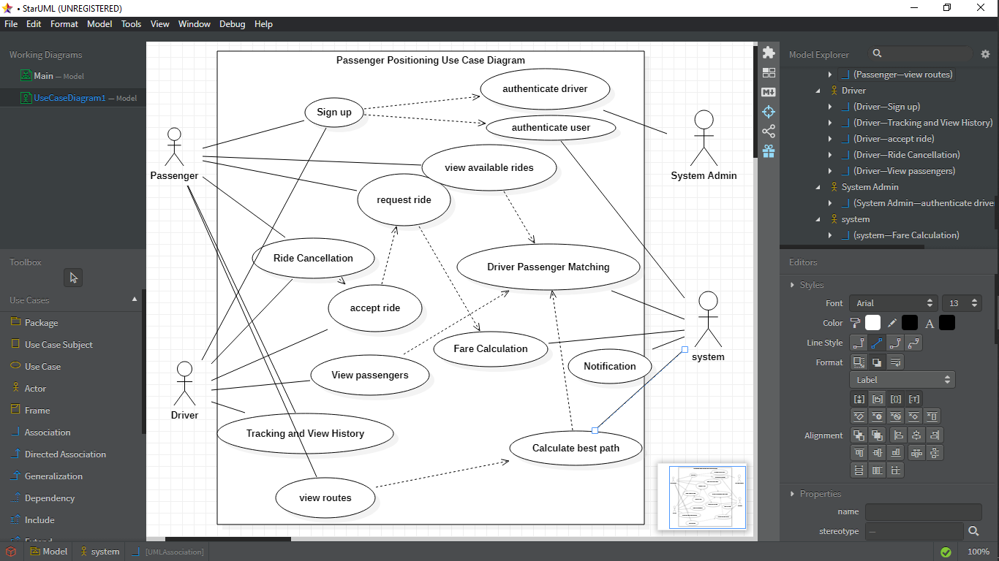
USE CASE DIAGRAM

Slide 8
TECHNOLY STACK

Slide 9
VERIFICATION AND VALIDATION
Review of Other Apps
Market Research Mechanism
Results

Slide 10
Review Of Other Apps
LOCAL APPLICATIONS
INTERNATIONAL APPLICATIONS
UBER
LYFT
GOJEK
CAREEM
OLA
VIA
BLABLA CAR
BRIDJ
GOKID
HITCH
GOZEM APP
BEEGROUP
YANGO
ZGO

Slide 11
SURVEYS AND INTERVIEWS
Physical Interviews
Online Surveys
Local Taxi Drivers
Road Users
Online Interviews
Google Forms

Slide 12
SURVEY QUESTIONS
1. Have you ever used a passenger positioning application before?
2. How important is real-time information about the location of your bus/train to you?
3. How often do you experience delays or disruptions in your public transportation schedule?
4. Which features are most important to you in a passenger positioning application?
5. What would make you stop using a passenger positioning application?
6. How reliable do you expect the real-time information to be?
7. How important is the accuracy of the estimated arrival time of your taxi?
8. How much of a delay would cause you to consider alternative transportation options?
9. Would you be interested in seeing a map of your taxis route and current location?
10. How important is it to have the ability to save and view your favorite stops/routes?

Slide 13
THANK
YOU!!!!!

